Slide 1

WORLD
POPULATION
Muhammed Nasim

Slide 2

INTRODUCTON
This power point presentation explore the vast realm of population data, and I will demonstrate how SQL queries can be utilized to extract, analyze, and interpret this valuable information. By harnessing the potential of SQL, we can delve into demographic trends, identify patterns, and unveil hidden correlations within extensive datasets.
Dataset : World population
Query Tool : SQL

Slide 3
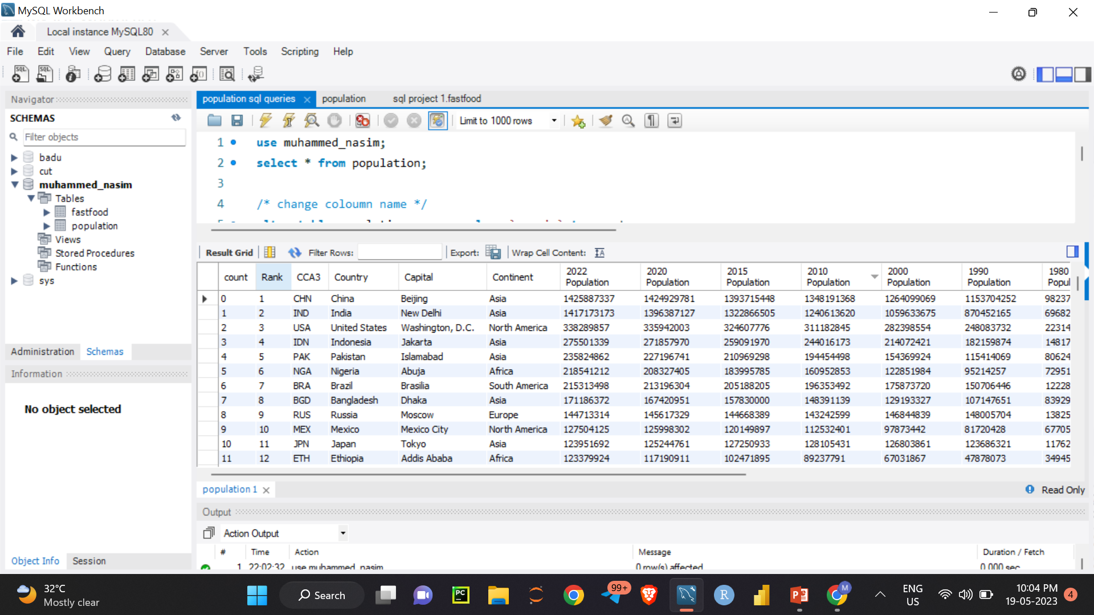
QUERY 1
use muhammed_nasim;
select * from population;

Slide 4
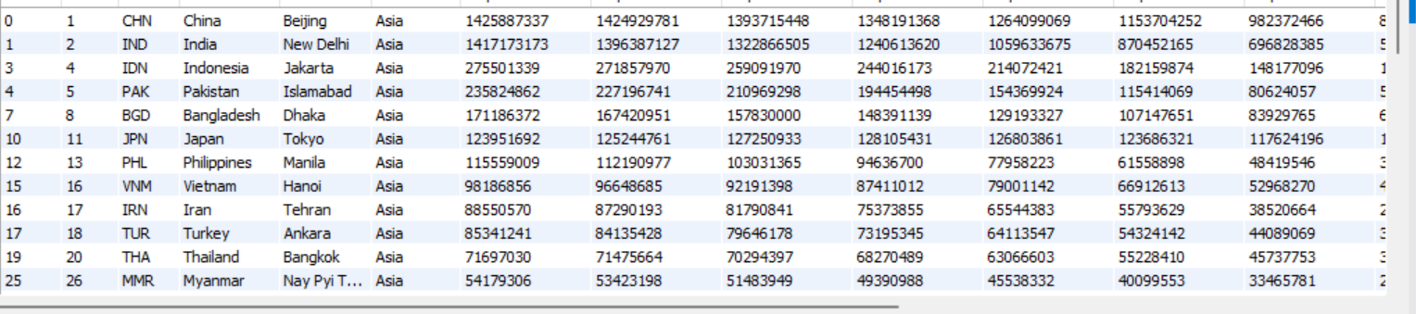
QUERY 2
select data’s of asian countries.
select * from population where Continent='Asia';

Slide 5
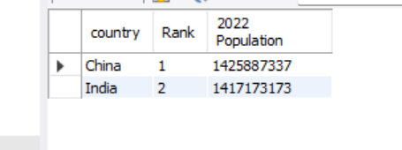
QUERY 3
select first 2 country with most population
select country,`Rank`,`2022 Population` from population order by `2022 Population` desc limit 2;

Slide 6
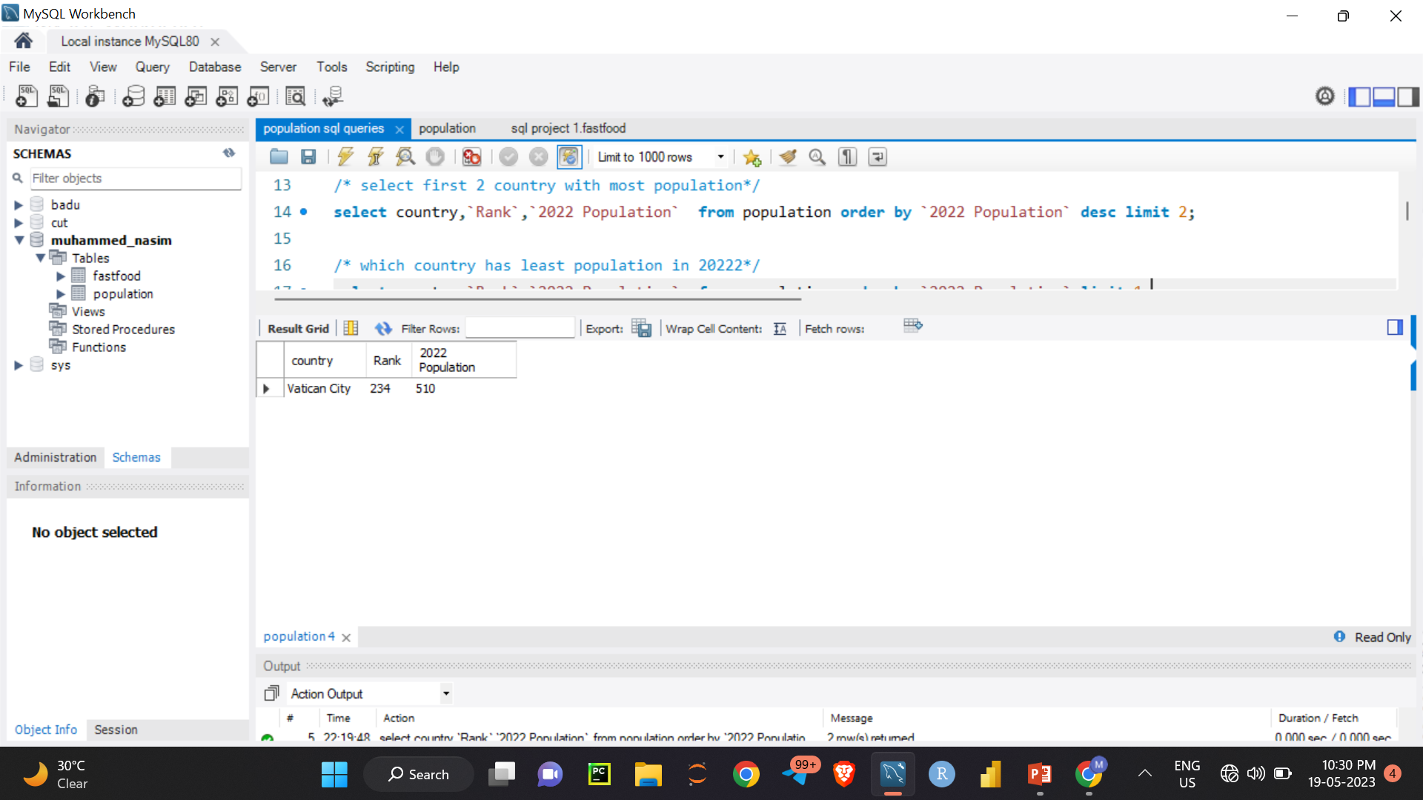
QUERY4
which country has least population in 20222
select country,`Rank`,`2022 Population` from population order by `2022 Population` limit 1;

Slide 7
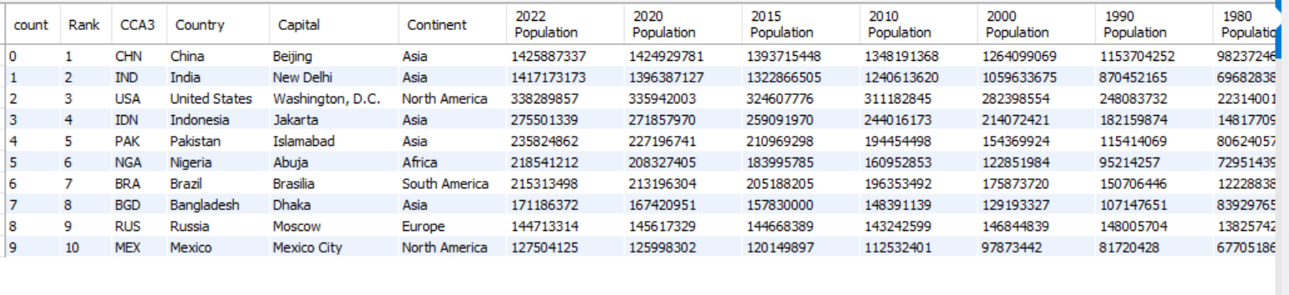
QUERY5
which are the most populated 10 countries
select * from population where `Rank` between 1 and 10 ;

Slide 8
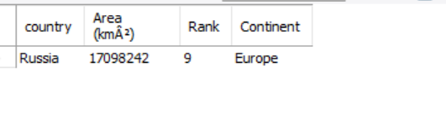
QUERY 6
select country with more area
select country,`Area (kmÂ²)`,`Rank`,`Continent` from population order by `Area (kmÂ²)` desc limit 1

Slide 9
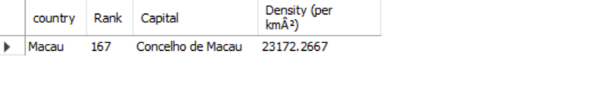
QUERY 7
which country has highest density per kilometer
select country,`Rank`,`Capital`,`Density (per kmÂ²)` from population order by `Density (per kmÂ²)` desc limit 1;

Slide 10
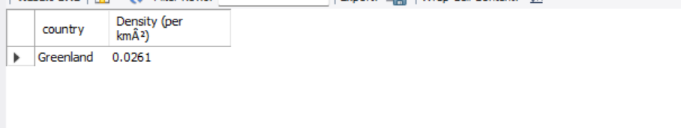
QUERY 8
which country has lowest density per kilometer
select country,`Density (per kmÂ²)`from population where `Density (per kmÂ²)` = (select(min(`Density (per kmÂ²)`))from population);

Slide 11
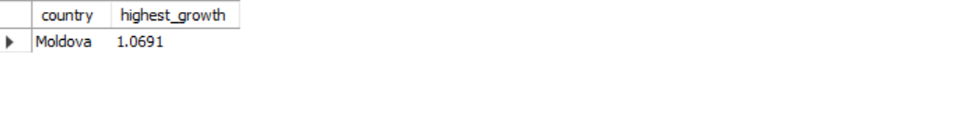
QUERY9
which country has highest growth rate
select country ,`Growth Rate` as highest_growth from population where `Growth Rate`= (select(max(`Growth Rate`)) from population);

Slide 12

QUERY 10
country with least growth rate
select country,`Growth Rate` as lowest_growth from population where `Growth Rate` = (select(min(`Growth Rate`)) from population);

Slide 13
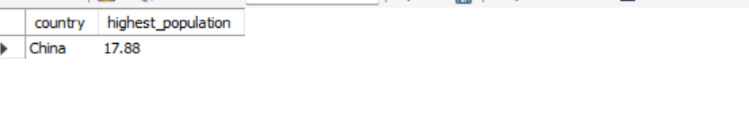
QUERY 11
which country has highest world population percentage
select country,`World Population Percentage` as highest_population from population where `World Population Percentage`= (select(max(`World Population Percentage`))from population);

Slide 14
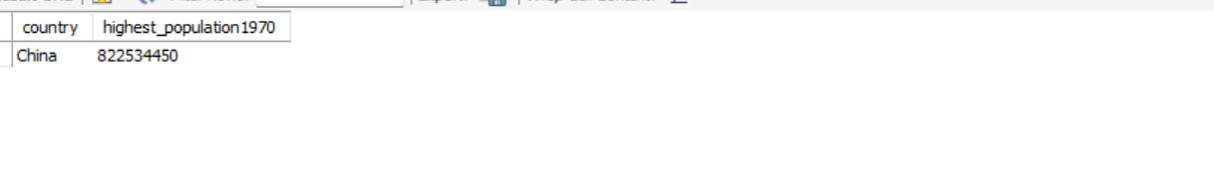
QUERY 12
which country has highest population in 1970
select country,`1970 Population` as highest_population1970 from populationwhere `1970 Population`= (select(max(`1970 Population`)) from population);

Slide 15
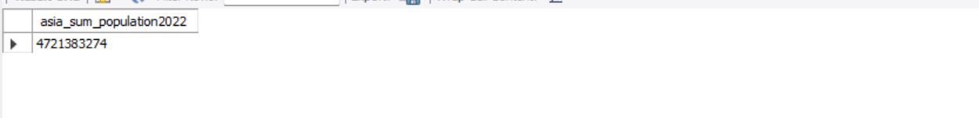
QUERY 13
sum of population of asia continent in 2022
select sum(`2022 Population`) as asia_sum_population 2022 from population where continent = 'asia’ ;

Slide 16
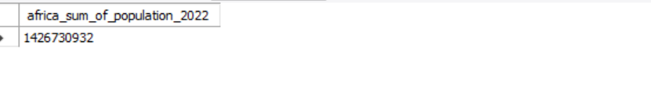
QUERY 14
Toral population of africa continent in 2022
select sum(`2022 Population`) as africa_sum_of_population_2022 from population where continent = 'africa' ;

Slide 17
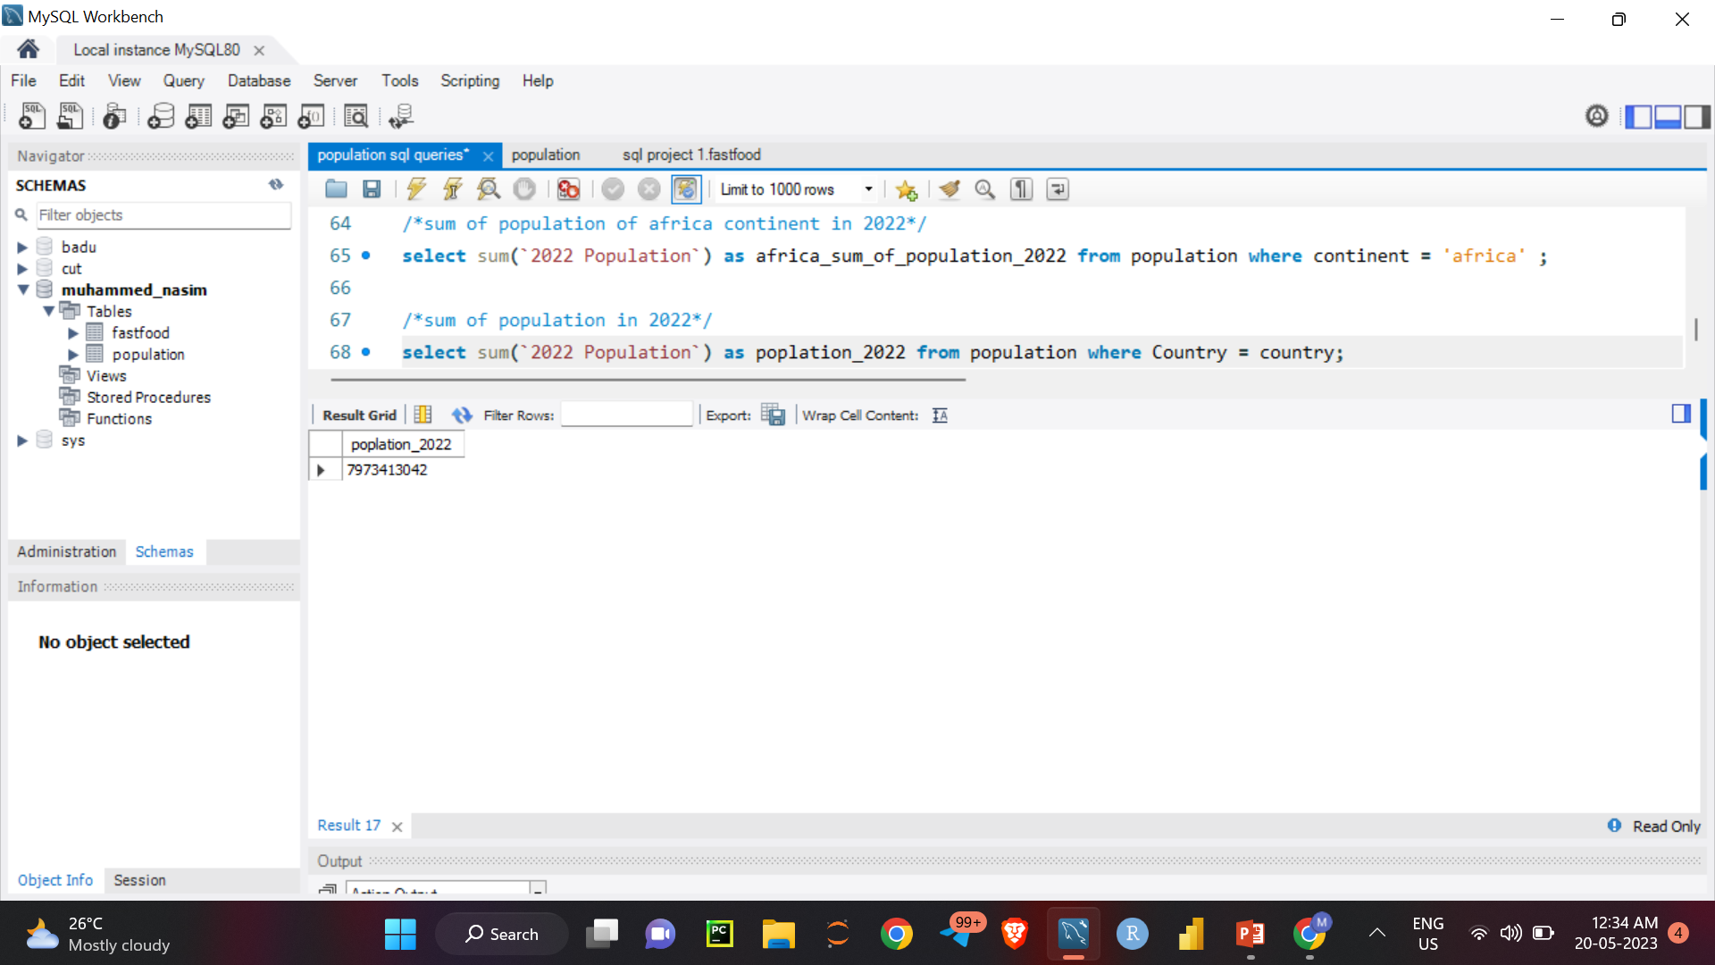
QUERY 15
sum of population in 2022
select sum(`2022 Population`) as population_2022 from population where Country = country;

Slide 18

THANK YOU

